Slide 1
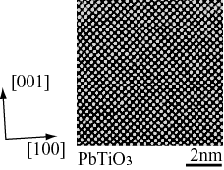
P1-15 Hydrothermal PbTiO₃ epitaxial thin films
Pierre Curie (University of Paris)
Shotgun-presentation is for inviting researchers to your poster. Simple and strong impression is important. In front of your poster, do the detail explanation.
Title can be simplified; but don’t forget to put your ID (ex. P1-15).
Only presentation author’s name should be indicated.
The font size should be larger than 24. “Times New Roman” is preferable.
Presentation time is 90 sec.
Maximum ppt file size is 2MB.
  Fig. 1 PE-hysteresis
  Fig. 2 TEM observation

